Slide 1
𝔾ℝ𝔸ℙ𝕀ℂ 𝔻𝔼𝕊𝕀𝔾ℕ
STUDENT NAME:sharmila
REGISTER NO AND NIMD :
asanm11324131131802522016
DEPARTMENT: bsc. Computer science
COLLEGE NAME :113-vallalar Arts and
science collega /Annamalai university

Slide 2

ℙℝ𝕆𝕁𝔼ℂ𝕋 𝕋𝕀𝕋𝕃𝔼
Digital portfolio

Slide 3
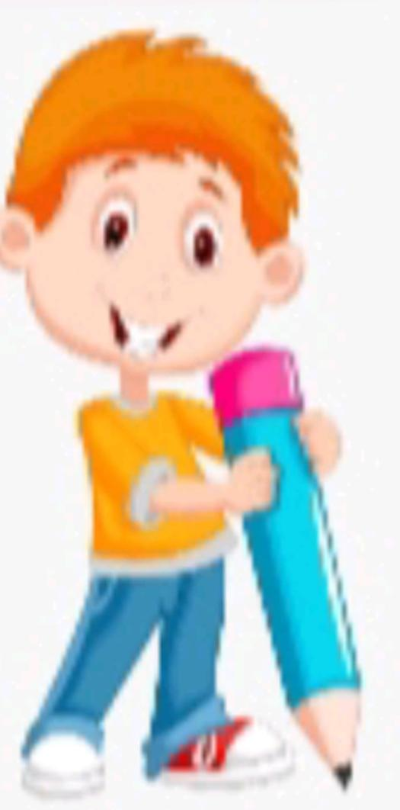
𝔸𝔾𝔼ℕ𝔻𝔸
Introductio
Core principal of Design
Tools of the trade
Design process
Portfolio highlight
Trends in graphic design
Conclusion

Slide 4
INTRODUCTION :
Graphic design is the art of combining visual elements to communicate ideas. It plays a key role in branding, advertising, digital products, and everyday communication. Add Visuals: Logo samples, posters, app Uis Modern, clean background with graphic icons

Slide 5
CORE PRINCIPAL OF DESIGN :
Balance: Equal distribution of elements Contrast: Differences in color, size, type for emphasis Hierarchy: Guides viewers to the most important info Alignment: Creates order and clarity Repetition: Builds consistency and branding Proximity: Groups related items together Color & Typography: Emotional tone and readability Visual Idea: Show an example design that applies these principles

Slide 6
TOOLS OF THE TRADE :
Adobe Photoshop – Image editing & digital art. Adobe Illustrator – Vector graphics & logos. CorelDRAW – Print & illustration design. Canva – Easy online design tool. Figma / Sketch – UI/UX and web design. Procreate – Digital illustration on tablets.

Slide 7
DESIGN PROCESS :
1. Research & Understand – Client needs, audience, and goals. 2. Brainstorm & Conceptualize – Generate creative ideas. 3. Sketch & Draft – Initial layouts and mockups. 4. Design & Develop – Use tools to create visuals. 5. Feedback & Revisions – Improve based on reviews. 6. Finalize & Deliver – Export and present finished work.

Slide 8
PORTFOLIO HIGHLIGHTS:
Showcase best projects: Logo & Branding designs. Website & UI/UX layouts. Posters, Flyers, and Social Media Ads. Motion graphics or animations. A portfolio demonstrates skills, creativity, and style to clients or employers.

Slide 9
TRENDS IN GRAPHIC DESIGN
Minimalism – Clean and simple designs. 3D & Motion Graphics – Adds depth and interaction. Bold Typography – Strong, attention-grabbing fonts. Sustainable Design – Eco-friendly concepts. AI-Assisted Design – Faster creative workflows. AR/VR Integration – Immersive experiences.

Slide 10
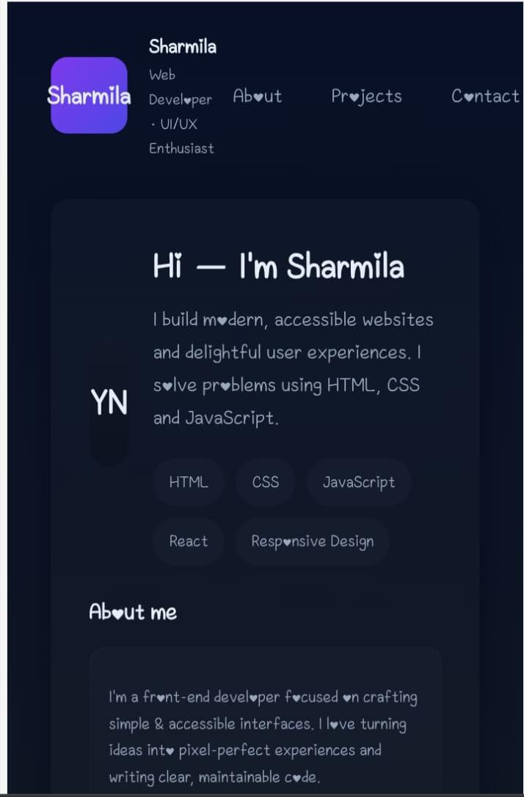

Slide 11
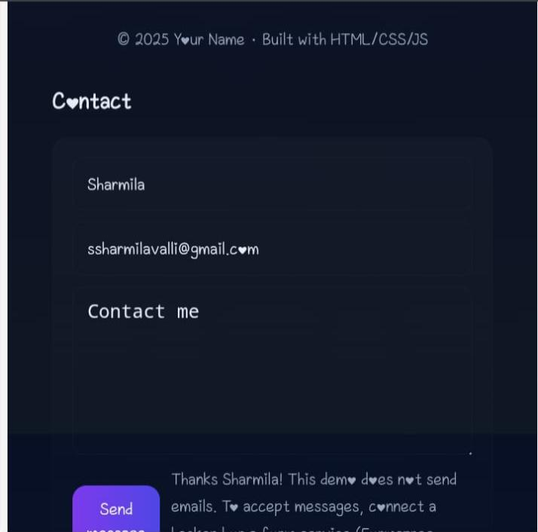

Slide 12

CONCLUSION:
Graphic design blends creativity and technology. Tools + Process = Professional Results. Portfolios showcase talent and growth. Trends shape the future of design. “Design is not just what it looks like, but how it works.”

